Slide 1
Spring Boot Micro Services

Slide 2
MicroServices
Microservices - also known as the microservice architecture - is an architectural style that structures an application as a collection of services that are
Highly maintainable and testable
Loosely coupled
Independently deployable
Organized around business capabilities
Owned by a small team

Slide 3
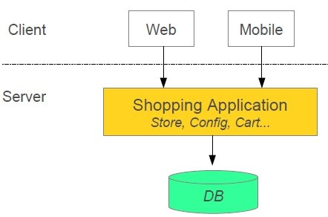
Monolithic Application

Slide 4
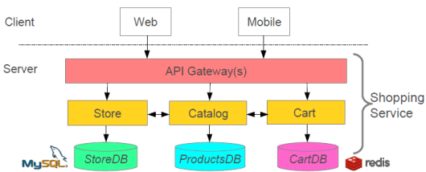
With Microservices

Slide 5
12 factor approach
A 12-factor app is a methodology or set of principles for building scalable and performant, independent, and most resilient enterprise applications
It establishes the general principles and guidelines for creating robust enterprise applications
12-factor app principles got very popular as it aligns with Microservice principles.

Slide 6
12 factor approach
1. Codebase
There is only one codebase per app
in microservices architecture, it’s one codebase per service ─ but there can be numerous deploys
A deploy is a running instance of the app
2. Dependencies
manage the dependencies externally using dependency management tools(maven,gradle) instead of adding them to your codebase
3. Configurations
store all configuration data separately from the code – in the environment as variables and not in the code repository — and read in by the code at runtime
A separate config file makes it easy to update the config values without touching the actual codebase

Slide 7
12 factor approach
4. Backing Services
Backing services are services that the application depends on for operation like database
Treat all such backing services as attached resources.
it shouldn’t require any code change to swap a compatible backing service. The only change should be in configurations
5. Build, Release, Run
strict separation between the build, release, and run stages
Build stage: transform the code into an executable bundle/ build package.
Release stage: get the build package and combine with the configurations of the deployment environment and make your application ready to run.
Run stage: It is like running your app in the execution environment.
use CI/CD tools like Jenkins
Docker images make it easy to separate the build, release, and run stages

Slide 8
12 factor approach
6. Processes
Execute the app as one or more stateless processes
Ensuring the app is stateless makes it easy to scale a service horizontally by simply adding more instances of that service
Store any stateful data or data that needs to be shared between instances, in a backing service such as a database
7. Port binding
The app should be completely self-contained and not rely on the runtime injection of a webserver
The web app exports HTTP as a service by binding to a port, and listening to requests coming in on that port

Slide 9
12 factor approach
8. Concurrency
Scale-out via the process model
Supporting concurrency means that different parts of an app can scale up to meet the need at hand
When you develop the app to be concurrent, you can spin up new instances effortlessly.
9. Disposability
An app’s processes should be disposable so they can be started, stopped, and redeployed quickly with no loss of data
Services deployed in Docker containers do this automatically and the app can be stopped and started instantly.
The concept of disposable processes means that an app can die at any time, but it won’t affect the user
The app can be replaced by other apps, or it can start right up again.

Slide 10
12 factor approach
10. Dev/Prod parity
Continuous deployment requires continuous integration based on matching environments
Containers work well for this as they enable you to run the exact same execution environment all the way from local development through production
Don’t use different backing services between development and production, even when adapters theoretically abstract away any differences
11. Logs
Logs provide visibility into the behavior of a running application.
Separate the log generation and processing the log's information.
execution environment takes care of capture, storage, and archival of such logs

Slide 11
12 factor approach
12. Admin Processes
Separate administrative tasks from the rest of the app to prevent one-off tasks from causing issues with your running apps
Containers make this easy, as you can spin up a container just to run a task and then shut it down.
Examples include doing data cleanup, running analytics for a presentation
Though the admin processes are separate, you must continue to run them in the same environment and against the base code and config of the app itself.
Shipping the admin tasks code alongside the app prevents drift.

Slide 12
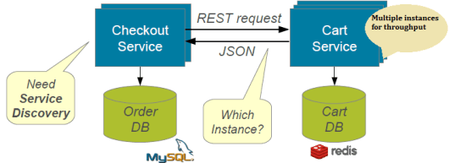
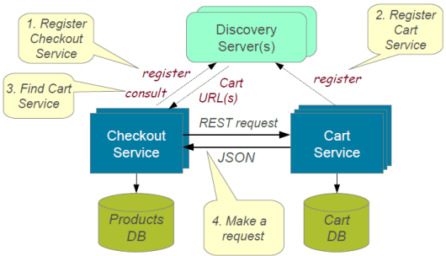
Discovery Service
Services should be able to discover each other

Slide 13
Spring cloud Micro Service Support
New service can be created using Spring Boot
Expose resources via RestController
Consume remote services using RestTemplate
Spring cloud support
Netflix Eureka Discovery Service
Netflix Ribbon for load balancing
Netflix Zuul for reverse proxy
Netflix Feign client abstraction to service calls
……… Many others

Slide 14
RestTemplate example
String customerUrl = "http://localhost:8081/customers/{id}";
String productUrl = "http://localhost:8082/products/{id}";
RestTemplate template = new Resttemplate();
Customer customer = template.getForObject(customerUrl, Customer.class, customerId);
Product product = template.getForObject(productUrl, Product.class, productId);

Slide 15
Eureka Server
Eureka Server is Netflix discovery service
Eureka server is in turn a Eureka client
Eureka Clients have to register with EurekaServer so that they can be discovered
Eureka Clients send heartbeat in fixed interval to show that they are up and running
If heartbeat is not received, Eureka Server removes the service from registry
Eureka Clients may fetch the registry to know the list of microservices available

Slide 16
Create Eureka Server
Create a spring boot starter project with the following dependencies
Eureka server
Web
Use @EnableEurekaServer on the application class
Provide the following properties
server.port=8761 (default for eureka server)
eureka.client.register-with-eureka=false
eureka.client.fetch-registry=false
Access with url http://host:8761/eureka

Slide 17
Eureka Client
Eureka clients are discoverable through eureka server
Create a spring boot starter project with the following dependencies
Eureka client
Web
Use @EnableDiscoveryClient or @EnableEurekaClient
Provide the following properties
server.port=8082
Spring.application.name=servicename
eureka.client.fetch-registry=false
eureka.client.serviceUrl.defaultZone = http://localhost:8761/eureka
(above property not required if eureka server runs on 8761)

Slide 18
Load Balancing
Netflix provides Ribbon as client side load balancer for multiple instances of the same service
Use RestTemplate for basic load balancing
@LoadBalanced
@Bean
RestTemplate getRestTemplate() {
return new RestTemplate();
}
Configure Ribbon for Customized load balancing

Slide 19
WebClient
Spring WebClient is a non-blocking and reactive web client for performing HTTP requests
Maven dependency
<dependency>
<groupId>org.springframework.boot</groupId>
<artifactId>spring-boot-starter-webflux</artifactId>
</dependency>
Creating WebClient
WebClient webClient = WebClient.create();
WebClient webClient = WebClient.create("https://client-domain.com");

Slide 20
WebClient Builder API
WebClient webClient = WebClient.builder()
.baseUrl("http://localhost:3000")
.defaultCookie("cookie-name", "cookie-value")
.defaultHeader(HttpHeaders.CONTENT_TYPE, MediaType.APPLICATION_JSON_VALUE)
.build();
Sending requests
Mono<Employee> employeeMono = webClient.get()
.uri("/employees/{id}", 123)
.retrieve()
.bodyToMono(Employee.class);
Mono<ClientResponse> responseMono = webClient.get()
.uri("/employees/{id}", 123)
.exchange();

Slide 21
FeignClient
Feign is a declarative web service client.
It makes writing web service clients easier.
To use Feign create an interface and annotate it
It has pluggable annotation support including Feign annotations and JAX-RS annotations
Enable FeignClient
@SpringBootApplication
@EnableFeignClients
public class Application {
public static void main(String[] args) {
SpringApplication.run(Application.class, args);
}
}

Slide 22
FeignClient Example
@FeignClient("stores")
public interface StoreClient {
@RequestMapping(method = RequestMethod.GET, value = "/stores")
List<Store> getStores();
@RequestMapping(method = RequestMethod.POST,
value = "/stores/{storeId}", consumes = "application/json")
Store update(@PathVariable("storeId") Long storeId, Store store);
}

